Slide 1

ELECTRONIC DESIGN WORKSHOP (EDW)
TITLE: AIOT BASED SMART WASTE MANAGEMENT
SYSTEM FOR MALLS AND CORPORATIONS
(WASTE WIZARD)
Team Members:
Aditya Rane - 20070123002
Aditya Kuleyar - 20070123003
Arzoo Lakhani - 20070123011
Dhruv Dolas -20070123015

Slide 2
Introduction
Literature Survey
Block Diagram of project
Resources (Hardware and/or Software, dataset)
Experimentation and Results
Plan of work
References
Contents

Slide 3
Our current linear economy is unsustainable and is causing harm to the planet.
We need to adopt a circular economy model that mimics nature's infinite cycles to ensure a sustainable future for all.
One major challenge in implementing a circular economy is managing waste.
To tackle this problem, we propose the idea of a "Smart Bin" that combines waste management with data collection.
The Smart Bin will use sensors to monitor the amount and types of waste deposited, and communicate this data to a central database.
This data will be used to inform waste management strategies and identify opportunities for recycling and upcycling.
By implementing the Smart Bin system, we can reduce the amount of waste sent to landfills and promote a more sustainable and circular economy.
Introduction

Slide 4

Brief Objective
Malls lack efficient waste management systems, resulting in an inability to accurately monitor and record waste generated by different F&B companies.
Specifically, the existing waste management systems in malls have difficulty in identifying and recording the waste generated by individual F&B companies.
This leads to a lack of accountability and difficulty in assessing the environmental impact of each F&B company in the mall.
Additionally, the current waste management systems do not effectively address the issue of overflowing bins, causing inconvenience and hygiene problems for visitors.

Slide 5
Literature Review
Waste Wizard is a waste management system that uses technology to monitor and manage waste collection and disposal. The technology typically involves the use of sensors and software to track the fill level of a waste bin and predict when it needs to be emptied.
2015
2017
2019
Present
Smart Bin: A Novel Approach for Efficient and Effective Waste Management
Smart Bin: An Intelligent Waste Management System
Design and Implementation of a Smart Bin System for Waste Management Using IoT
Smart Bin: An approach using Machine learning and IOT

Slide 6
Computing hardware:
ESP 32 CAM module
Arduino UNO
LCD Touch Screen
System Description
Electrical Components:
Stepper motor
ULN2003 Motor Driver
HX711 Amplifier
Sensing Devices:
Ultrasonic Sensor
Load Cell

Slide 7
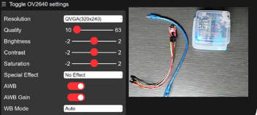
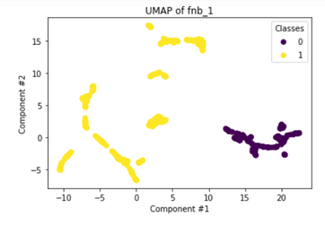
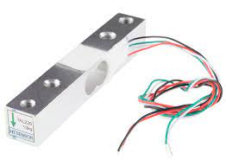
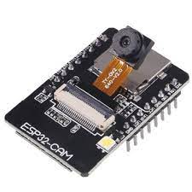
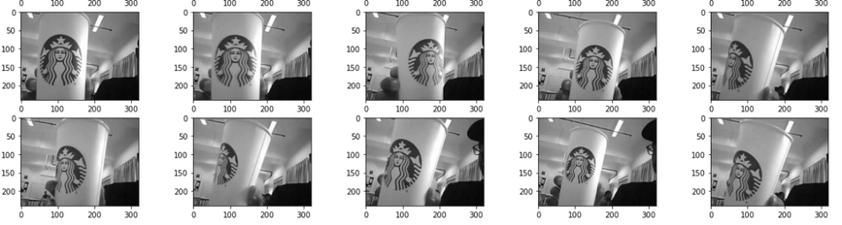


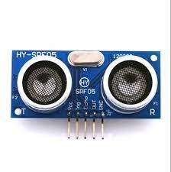
Flow Chart
Video Capture
Load Cell
Web Server
MjpegCollector(address=IP_ADDRESS_OF_ESP)
Classification
Image Extraction
Result published to serial monitor
Data uploaded in csv file
Level Sensing

Slide 8
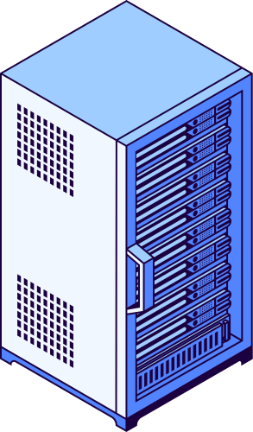


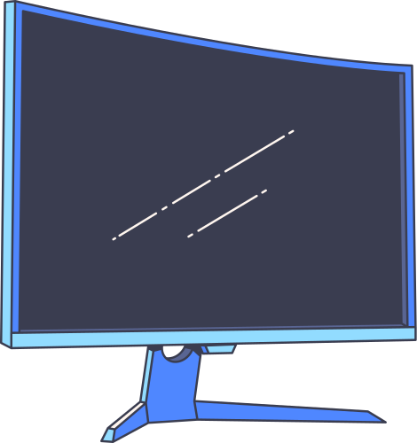
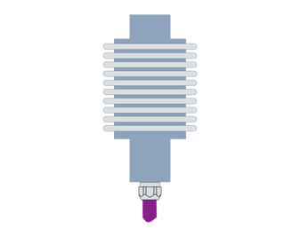

Work Flow
Video Capture
Web Server
Image Extraction
Classification
Level Sensing
Result published to serial monitor
Load Cell
Data uploaded in csv file

Slide 9
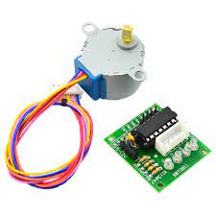
Methadology
ESP32 CAM
Level Sensing
Captures video feed and uploads it on a webserver.
Photos are captured from this video feed and then classified using the random forest classifier.
Senses if the dustbin is full or not.
Sends an alert to the maintenance crew if the dustbin is full.
Uses IOT and AI
Uses IOT
Load Cell
Stepper Motor
Captures the weight added to bin and sends to it the maintanenece crew via ESP32
Opens the bin automatically via an ultrasonic sensor.
Button is used to open manually.
Uses IOT
Uses IOT

Slide 10
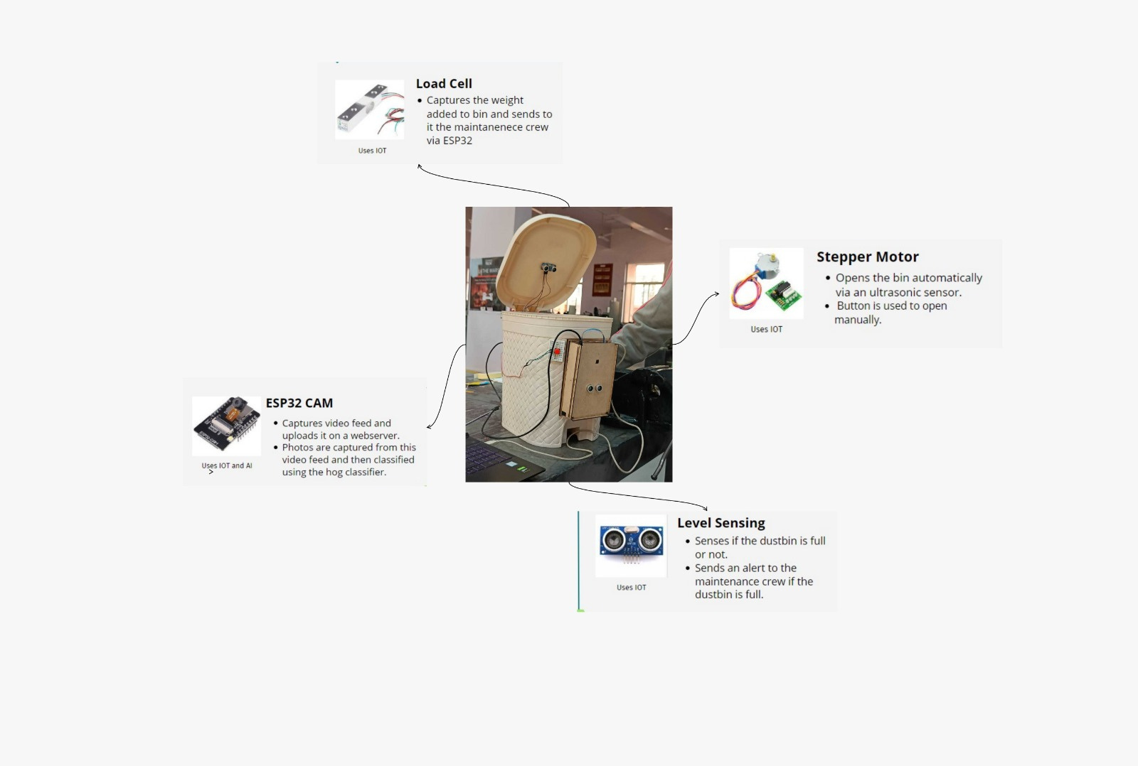

Slide 11
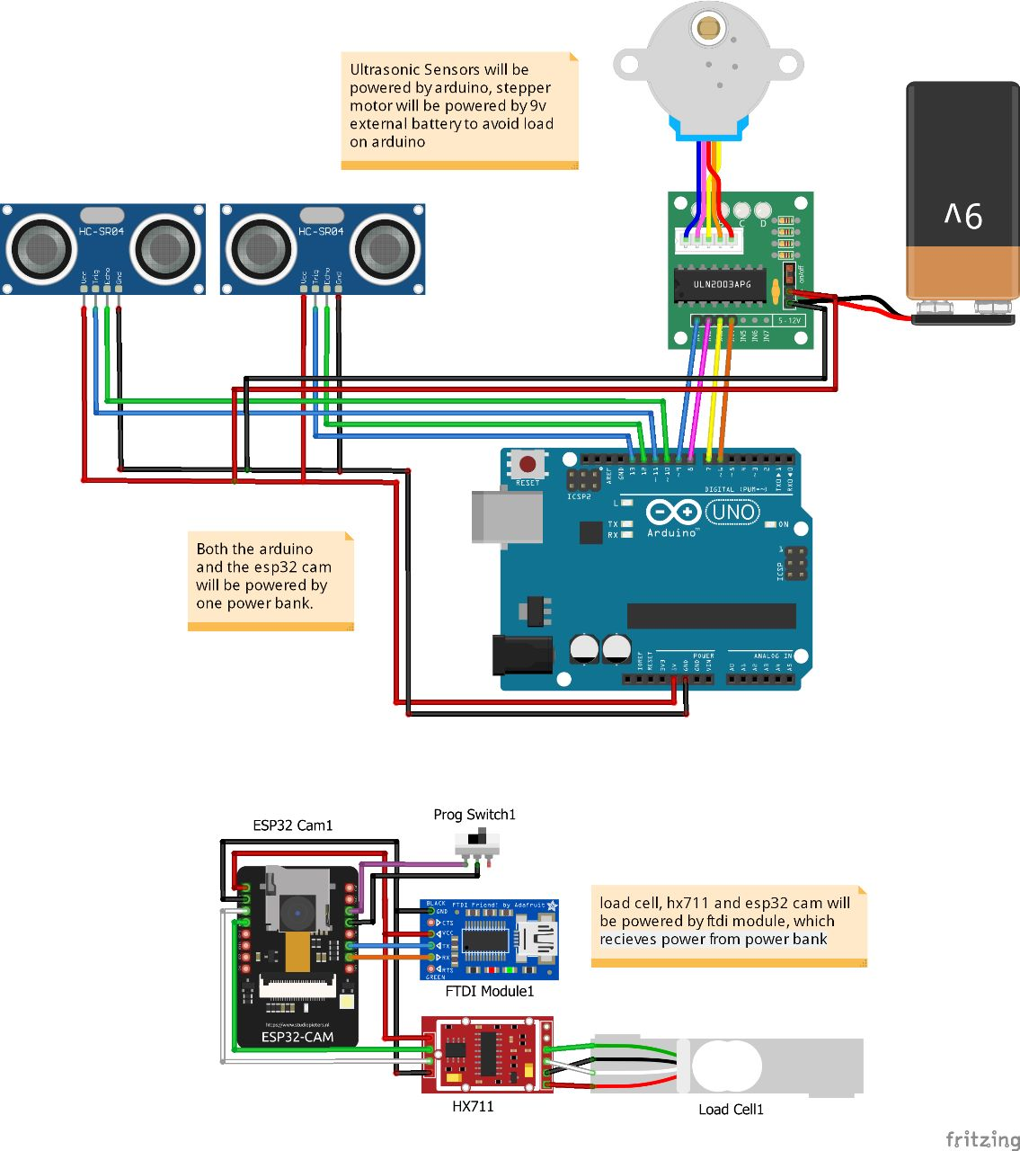
Circuit design

Slide 12
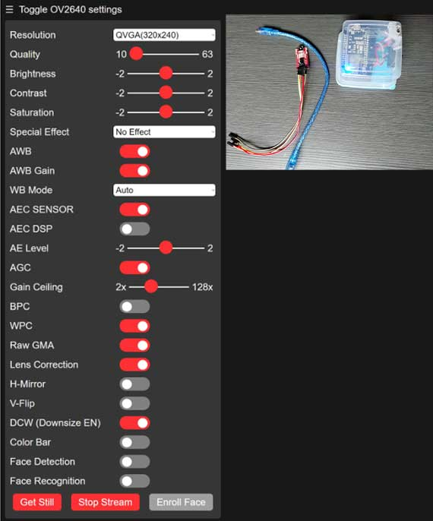
Web Server

Slide 13
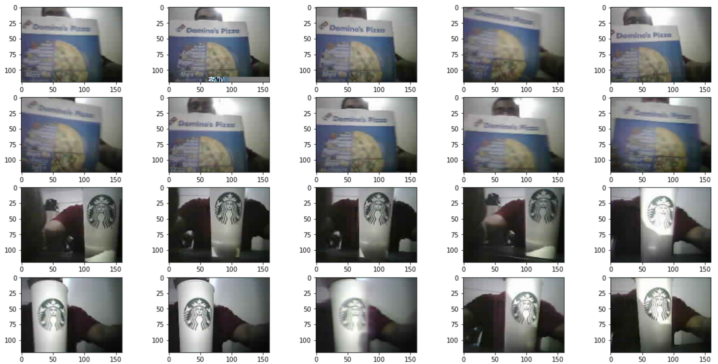
Custom Dataset

Slide 14
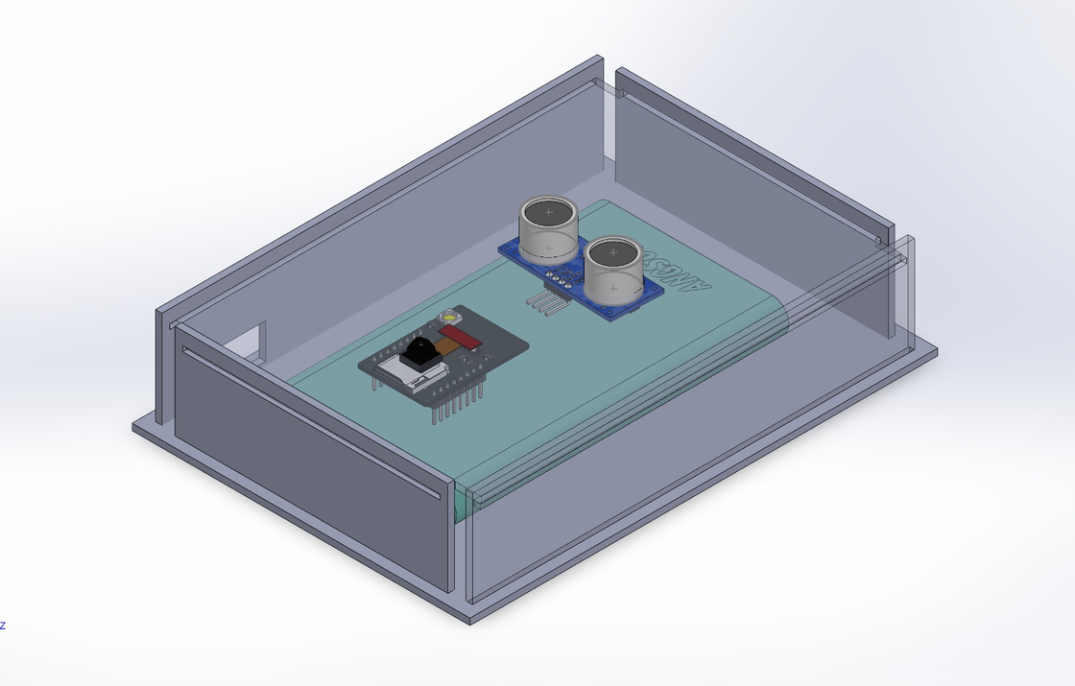
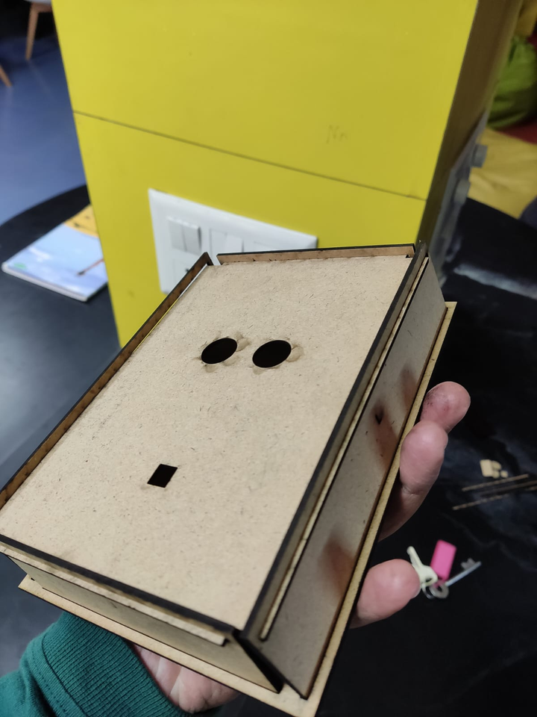
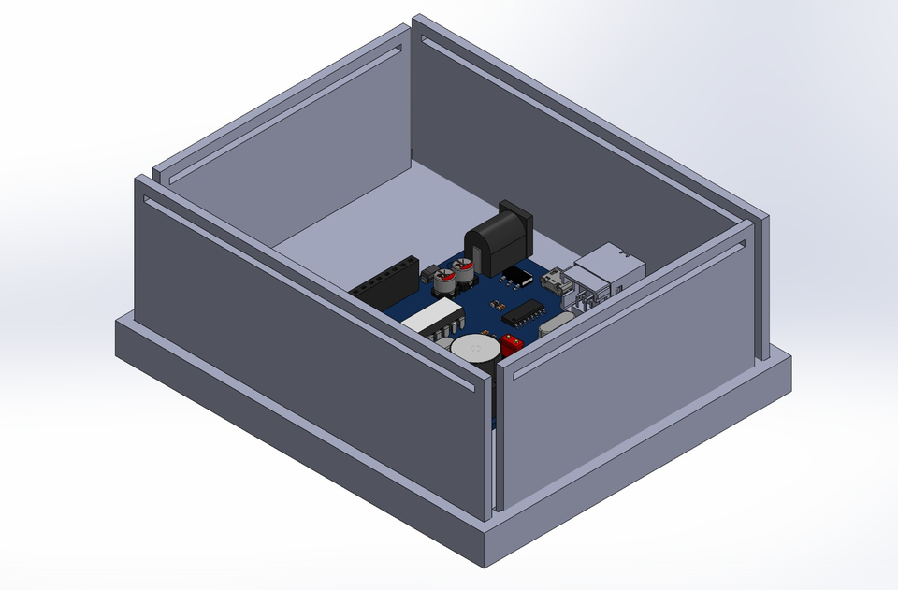
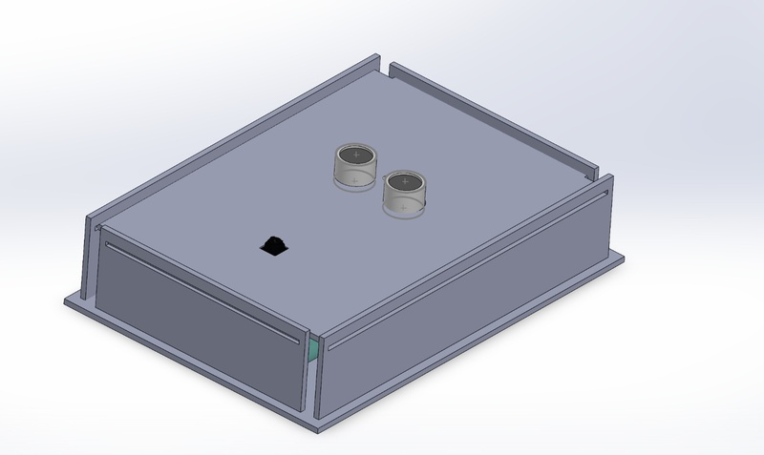
Design

Slide 15

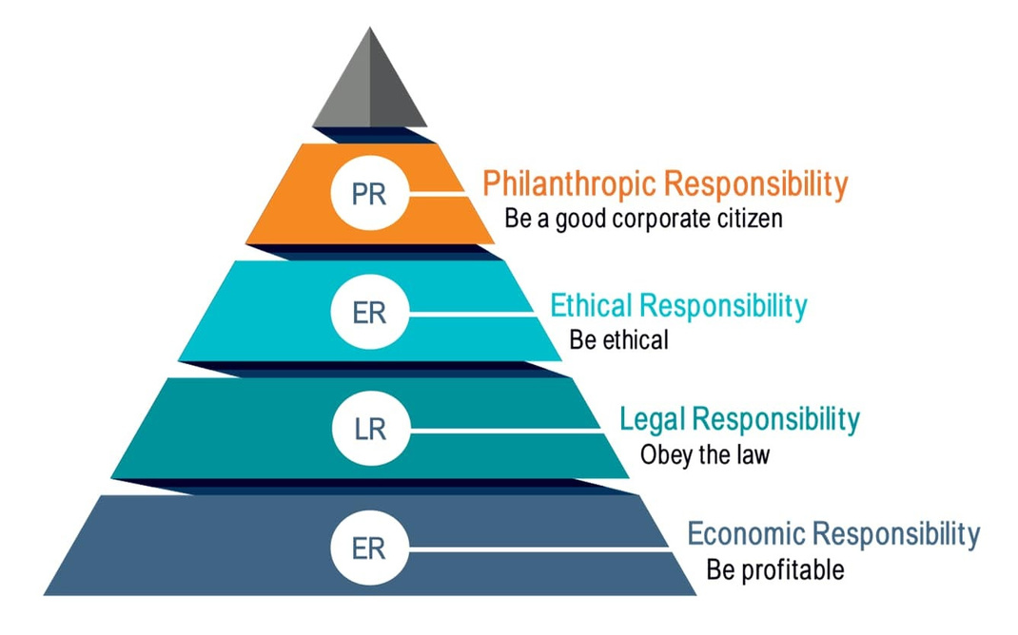
Benefits to Society
4 Corporate Social Responsibilities
Using this project, we will be fulfilling environmental and ethical responsibilities.
The aim of conducting a waste audit is to find out and identify the sources of this waste and then only we will be in a position to plan our ways to reduce it.

Slide 16
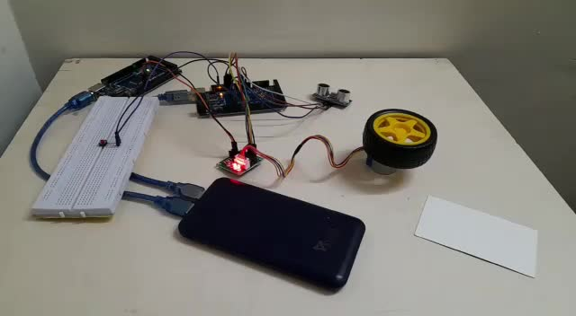
Results
Dual - mode opening mechanism (fool-proof)

Slide 17
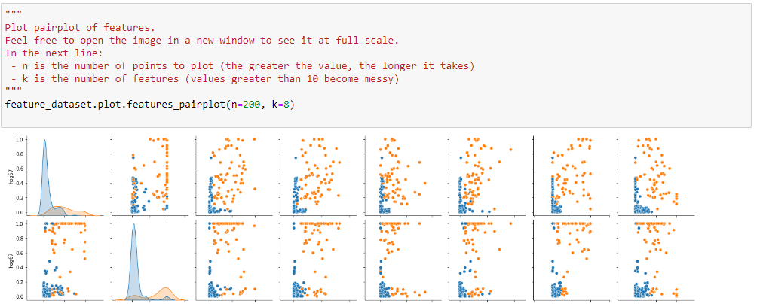
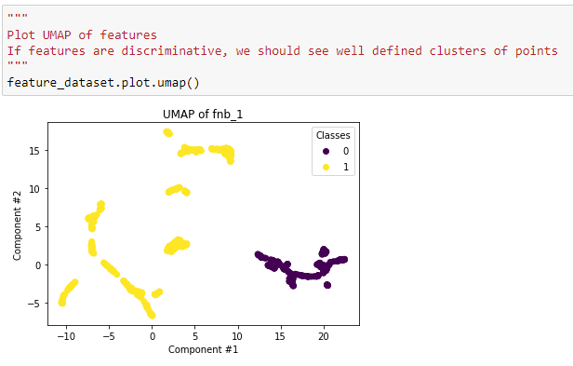
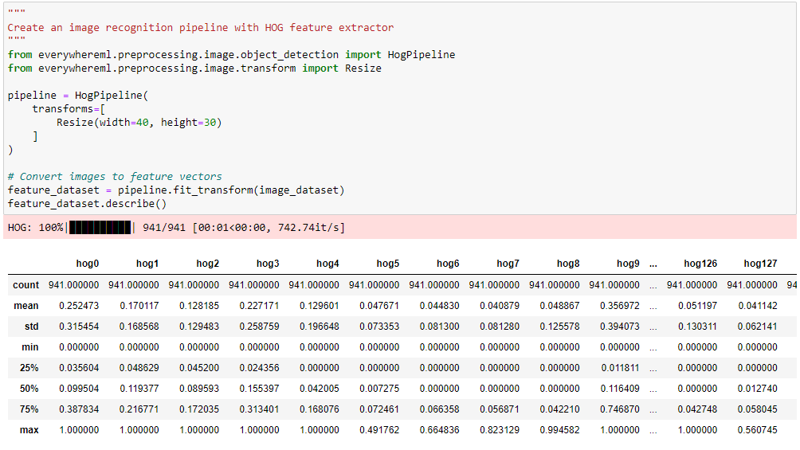
Results
Logo Detection Model

Slide 18
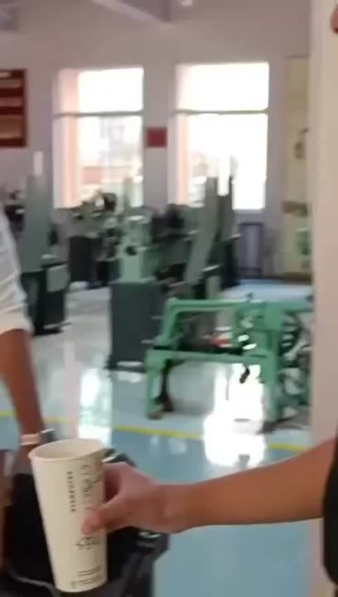
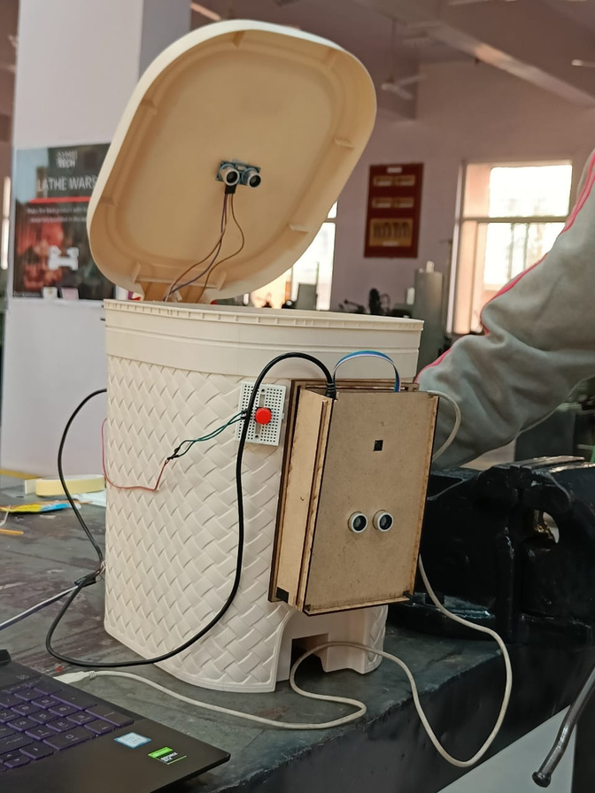
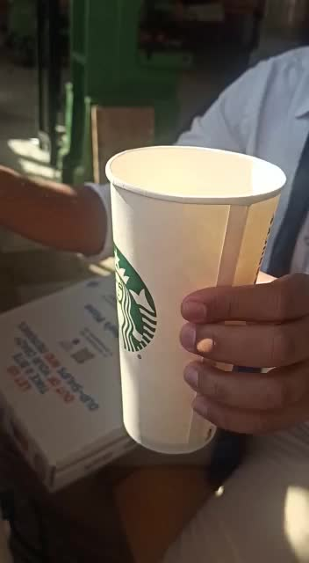
Results
Physical Structure and Outputs

Slide 19
Role of each Member
Aditya Rane:
Opening/Closing of Lid
Data collection from cell
Level Sensing
Touch Screen front end
Load Cell
ML Model building
Aditya Kuleyar
Dataset building
Code for Logo Detection
Working on stepper motor
Arzoo Lakhani
ESP32 Camera
ULN2003 Motor Driver
HX711 Amplifier
Dataset building
Dhruv Dolas
Dataset building
Code for logo detection
Code for logo recognition

Slide 20
References
https://eloquentarduino.com/esp32-cam-image-recognition/
https://ieeexplore.ieee.org/document/9632693
https://ieeexplore.ieee.org/stamp/stamp.jsp?arnumber=9165744
https://ieeexplore.ieee.org/stamp/stamp.jsp?arnumber=9615047
https://ieeexplore.ieee.org/document/8728531

Slide 21

Thank You

